Slide 1
The Vestibulo-Spinal Reflex

Slide 2
The Vestibulo-Spinal Reflex
The Vestibulospinal reflex is crucial for posture and balance control
It responds to head movements, tilting and orientation of the whole body
It originates from vestibular nuclei in brainstem
Descends through brainstem and spinal cord
Two Divisions: lateral (LVST) and medial (MVST) vestibulospinal tracts
LVST facilitates ipsilateral extensor muscle activity for posture
MVST influences neck muscle control for head stabilization
In comparison to the VOR which stabilizes gaze during head movements, ensuring clear vision, the
VSR adjusts muscle tone and posture to maintain balance and stability

Slide 3
Vestibulo-Spinal Reflex Assessment:
Narrow Stance – Static Head Position
Get your client in a narrow stance and have them stand still
Stand behind them to secure them in case of losing balance
Tell them to close their eyes (additional difficulty)
Look for swaying and signs of balance loss

Slide 4
Vestibulo-Spinal Reflex Assessment:
Narrow Stance – Dynamic Head Movements
Get your client in a narrow stance and have them stand still
Stand behind them to secure them in case of losing balance
Tell them to close their eyes (additional difficulty)
Have them move their heads in all 8 directions
Look for swaying and signs of balance loss

Slide 5
Vestibulo-Spinal Reflex Assessment:
Tandem Walks
Have your clients walk in a straight line
Depending on the fitness level cue heel to toes, when it’s too hard increase the width and distance of their steps
Tell them to close their eyes (additional difficulty)
Look for swaying and signs of balance loss

Slide 6
Vestibulo-Spinal Reflex Assessment:
Tandem Walks – Dynamic Head Movements
Have your clients walk in a straight line
Depending on the fitness level cue heel to toes, when it’s too hard increase the width and distance of their steps
Tell them to close their eyes (additional difficulty)
Have them move their head into different directions to isolate the accuracy of your assessment
Look for swaying and signs of balance loss

Slide 7
Vestibulo-Spinal Reflex Assessment:
Pertubation
Get your client in a narrow or shoulder width stance and have them stand still
Stand behind them to secure them in case of losing balance
Tell them to close their eyes (additional difficulty)
Apply soft taps on each shoulder and see how well they’re able to recover from it
Look for swaying and signs of balance loss – side to side

Slide 8
Vestibulo-Spinal Reflex Assessment:
Pertubation with head position changes
Get your client in a narrow or shoulder width stance and have them stand still
Stand behind them to secure them in case of losing balance
Tell them to close their eyes (additional difficulty)
Have them hold their in various directions to make your assessment even more precise
Apply soft taps on each shoulder and see how well they’re able to recover from it
Look for swaying and signs of balance loss – side to side

Slide 9
Otolith Organs - Assessments

Slide 10
Otolith Organs –
Utricle Assessments

Slide 11
Utricle Assessment – Head Tilts
Have your client look at a small business card, vision chart that they hold in their hands
Have them tilt their head to the left and make them read the business card
Switch sides and ask them which side feels clearer, easier to read from

Slide 12
Utricle Assessment – Head Tilts with balance challenge
Have your client look at a small target in front
Get them into position that challenges their balance – e.g. one leg stance, tandem stance, narrow stance
Have them tilt their head to one side then to the other
Observe sway, loss of balance, increased activity in the lower body (e.g. shaking of the foot, etc.)

Slide 13
Utricle Assessment – Full Body Side Tilts
Have your client look at a small target in the distance
Pick a stance that they feel comfortable in
Have them tilt their head and spine first to one side then the other
Observe possible signs of sway, loss of balance, etc.

Slide 14
Utricle Assessment – Lateral Walks
Have your client look at a Snellen Chart, or something they have to read from in the distance
Have them walk side ways to one side then the other, ask for changes in visual clarity

Slide 15
Utricle Assessment – Lateral Walks
Have your client look at a Snellen Chart, or something they have to read from in the distance
Have them walk side ways to one side then the other, ask for changes in visual clarity

Slide 16
Otolith Organs –
Saccule Assessments

Slide 17
Saccule Assessment – Gym Ball
Have your client look at a Snellen Chart, or something they have to read from in the distance
Have them bounce up and down and observe the ability to read clearly

Slide 18
Saccule Assessment – Jumps
Have your client look at a Snellen Chart, or something they have to read from in the distance
Have them bounce up and down and observe the ability to read clearly

Slide 19
Saccule Assessment – Standing up/Sitting down
Have your client look at a Snellen Chart, or something they have to read from in the distance
Have them sit down & stand up from a chair and ask them to focus on the chart
Ask if they discover a difference in visual clarity – sitting down vs. standing up

Slide 20
VOR-C assessments

Slide 21

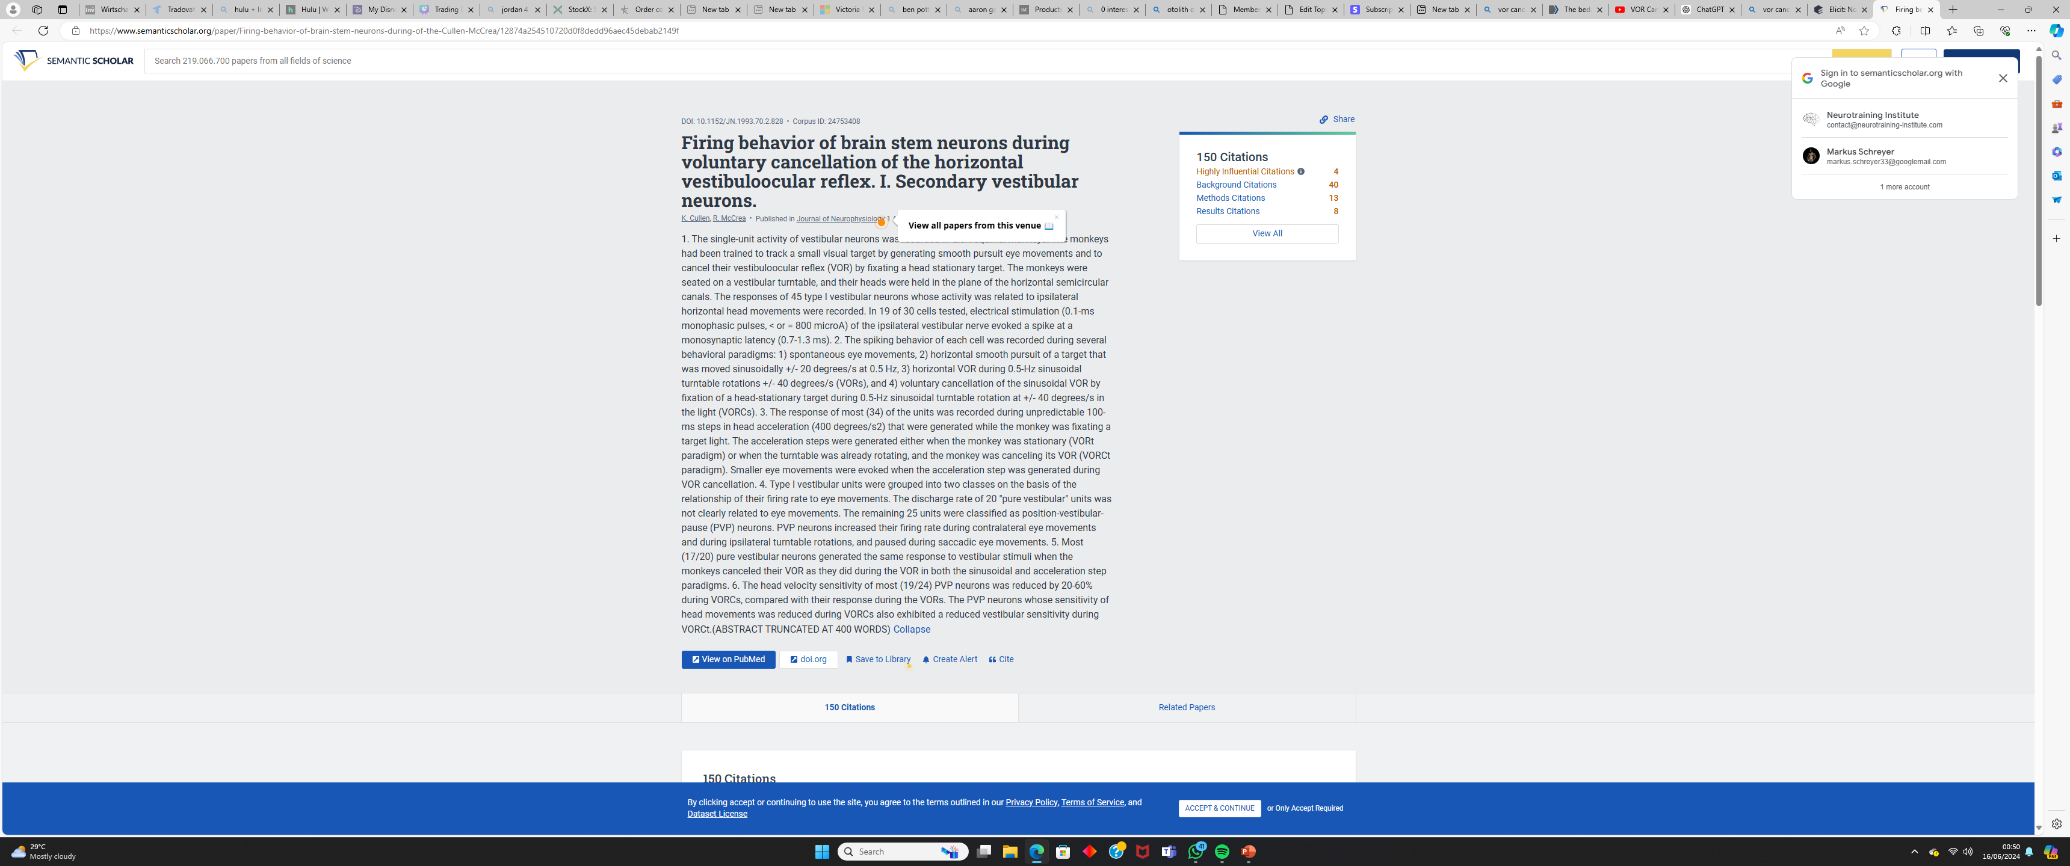
VOR Suppression (VOR-S)
It's a neurological mechanism that inhibits the Vestibulo-Ocular Reflex (VOR) when not needed
This Occurs during tasks like tracking moving objects or maintaining stable vision during head movements
It helps prevent unnecessary eye movements that could blur vision
It Involves complex integration of vestibular and is mainly controlled as a reflexive action of vestibular neurons in the vestibular nuclei (brainstem)
Deficits in VORS can impact visual tracking and stability, fall risk and more

Slide 22
VOR Suppresion (VOR-S) Assessment
Have your client look at a small business card, vision chart that they hold in their hands
Have them move their head simultaneously with their arm to all 8 cardinal positions
Ask them which direction it is hard to keep the focus/where the letters get blurry

